Slide 1
C21 2024 Agent Recruitment Program DASH User Guide

Slide 2
TABLE OF CONTENTS
PROGRAM TERMS AND CONDITIONS 3 Accepting Terms and Conditions 4
Viewing Terms and Conditions 6
Entering and Submitting Agents via dash 8
Viewing the Post Agent Submission Instructions 14

Slide 3
ACCEPTING THE PROGRAM’S TERMS AND CONDITIONS

Slide 4
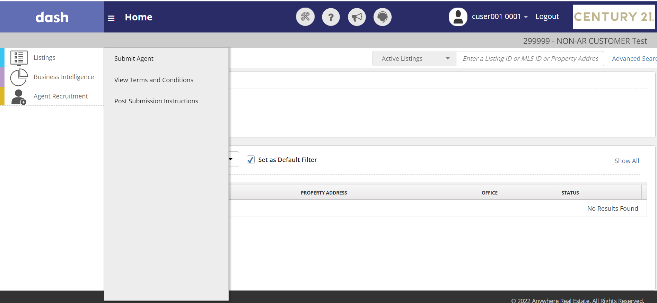
Log into dash and select the AGENT RECRUITMENT tab.
For the initial agent submission, the program’s Terms and Conditions must be accepted. To Accept the Terms and Conditions, click SUBMIT AGENT.
* Note: The Franchise Owner(s) or Legal Notice Contact must accept the program’s Terms and Conditions.

Slide 5
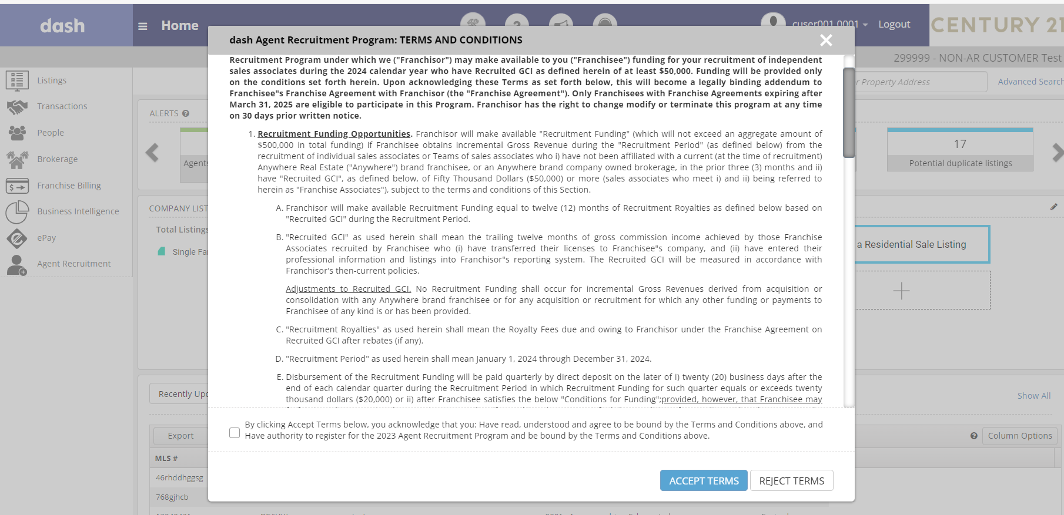
To submit agents for the program, the Terms and Conditions must be accepted first. Click Accept Terms.
If the Terms and Conditions are accepted, proceed to next slide for instructions to submit agents.

Slide 6
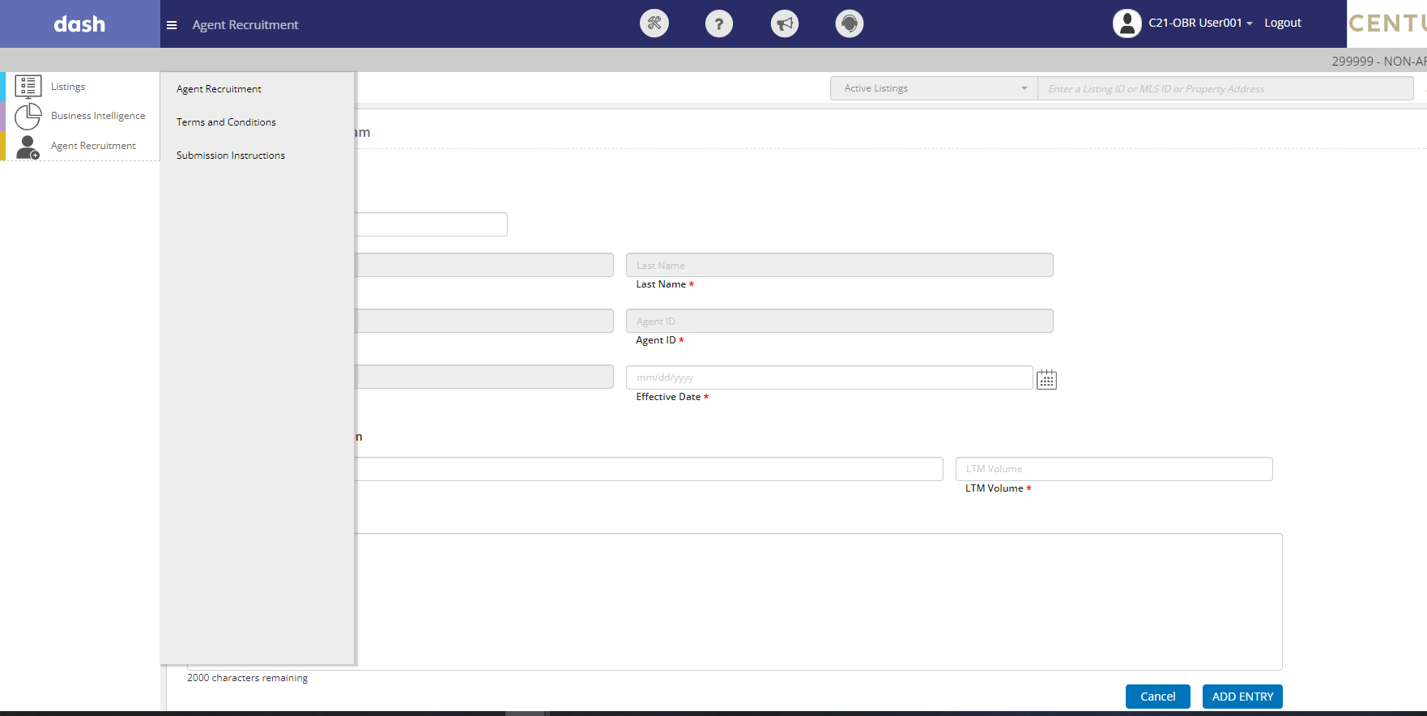
To view the Terms and Conditions, Log into dash and select the AGENT RECRUITMENT tab. Click View Terms and Conditions.

Slide 7
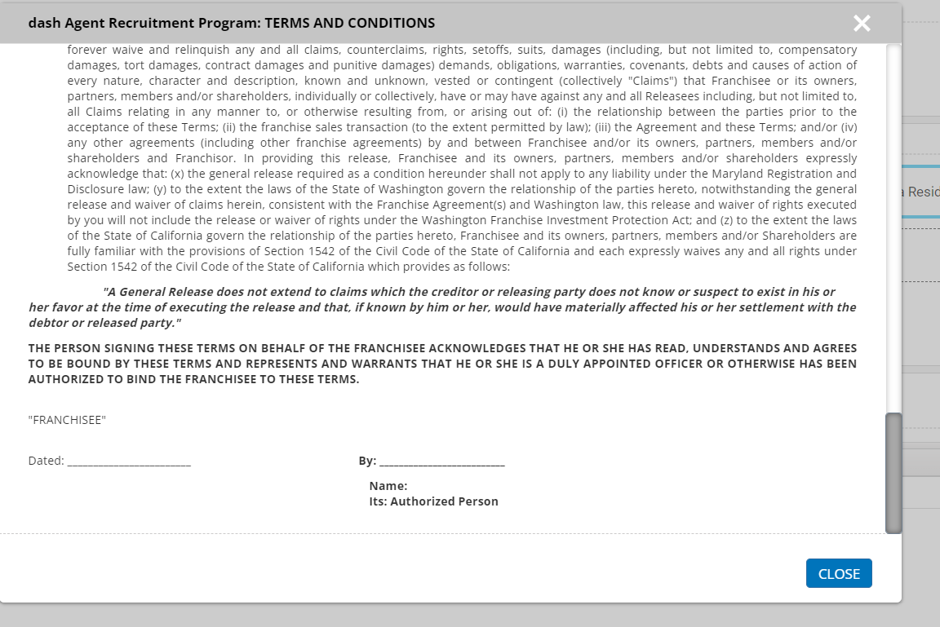
The Terms and Conditions will display.

Slide 8
ENTERING AND SUBMITTING AGENTS IN DASH

Slide 9
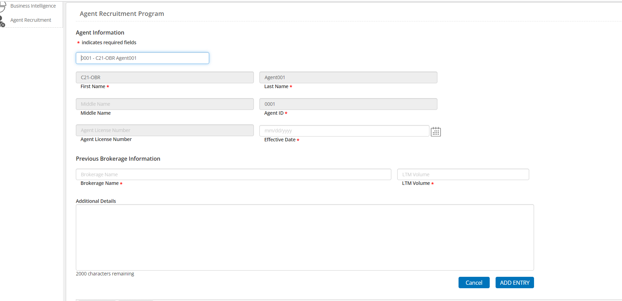
All fields with a * must be completed. Multiple agents may be submitted, repeat the following for each agent.
For Agent Information, enter the Agent’s first and late name or Agent ID. This will auto populate the Agent’s First Name, Last Name, Agent ID and Agent License Number.
For Effective Date, enter the date the agent started with your brokerage
For Previous Brokerage Information, enter the name of the brokerage the agent was previously associated with. Then enter the Last Twelve Months Volume (‘LTM Volume’). * LTM Volume must be a minimum of $2M
Additional Details- Enter additional details as needed. Please note if the agent is part of a team.
Click ADD ENTRY
Note: The Owner, Legal Notice Contact, Brokerage Admin, Office Manager, Company Data Entry Users can select/add agent/save agents at the company level.

Slide 10
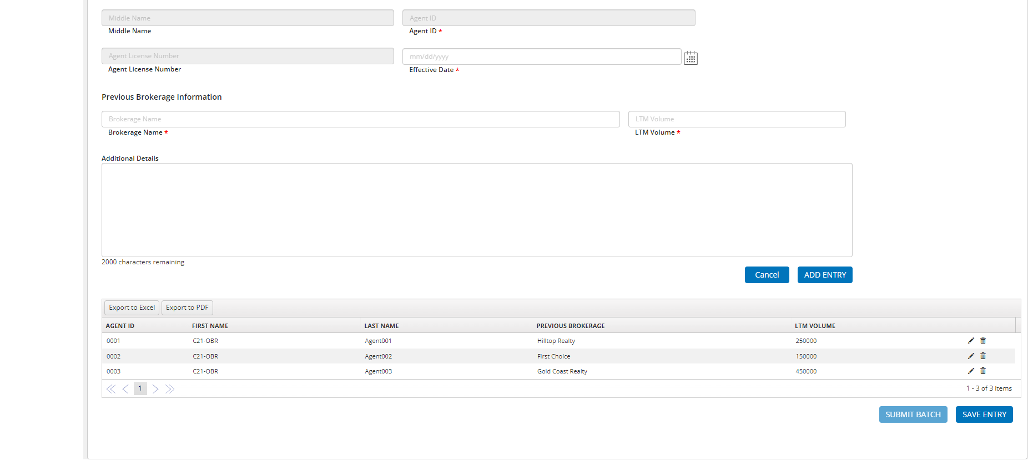
If there is more than one agent to enter, repeat the steps outlined on Slide 4 for each agent.
When the entry of agent is completed, click SAVE ENTRY
Agents that are added for this entry are displayed here.

Slide 11
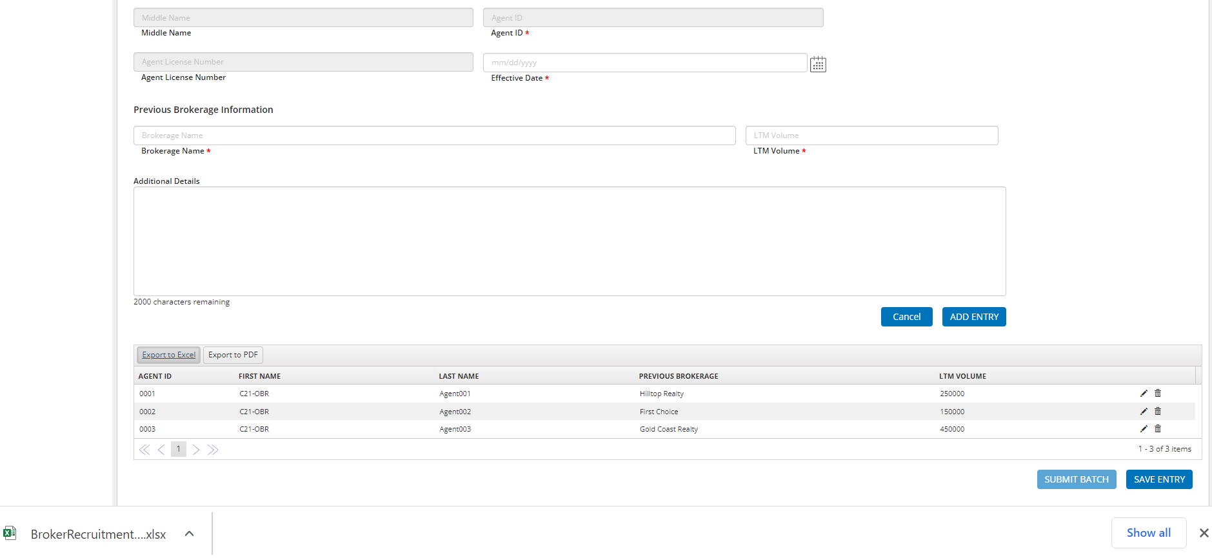
For a record of the agents submitted, click Export to Excel or PDF, then save for future reference.

Slide 12
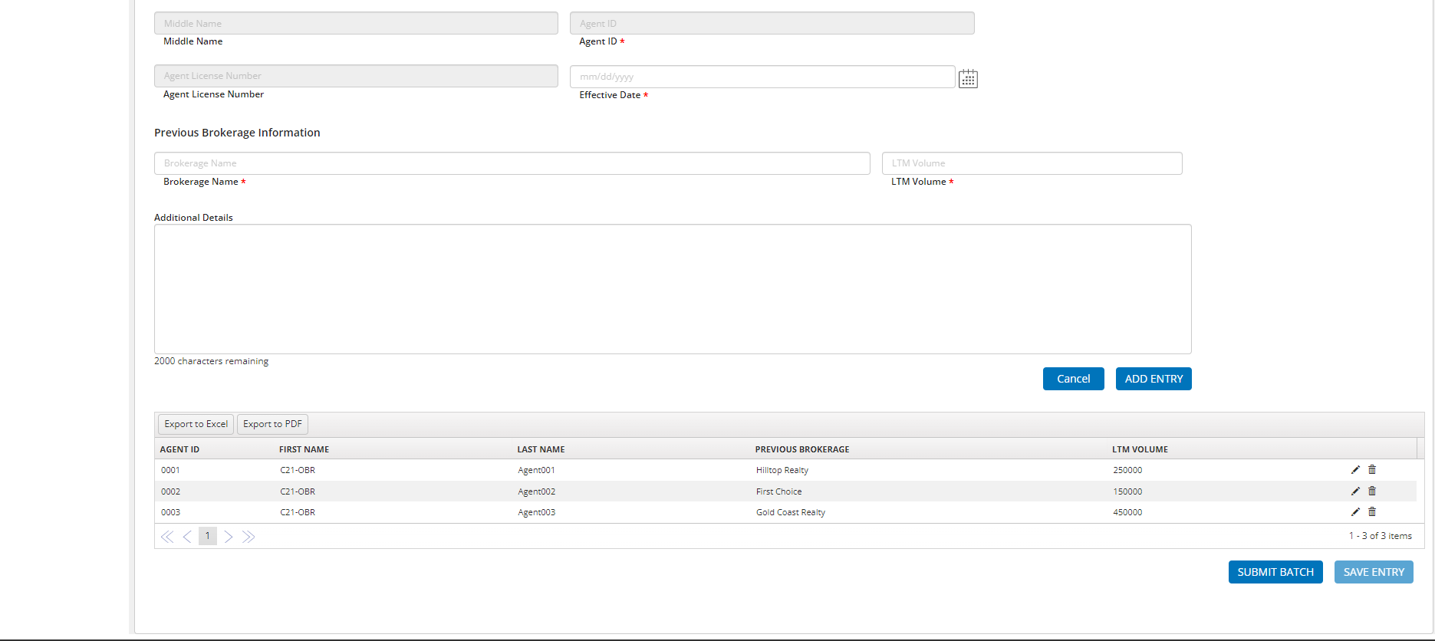
To submit agents for review, click SUBMIT BATCH
*Note: Only Owners and Legal Notice Contact can submit the batch

Slide 13
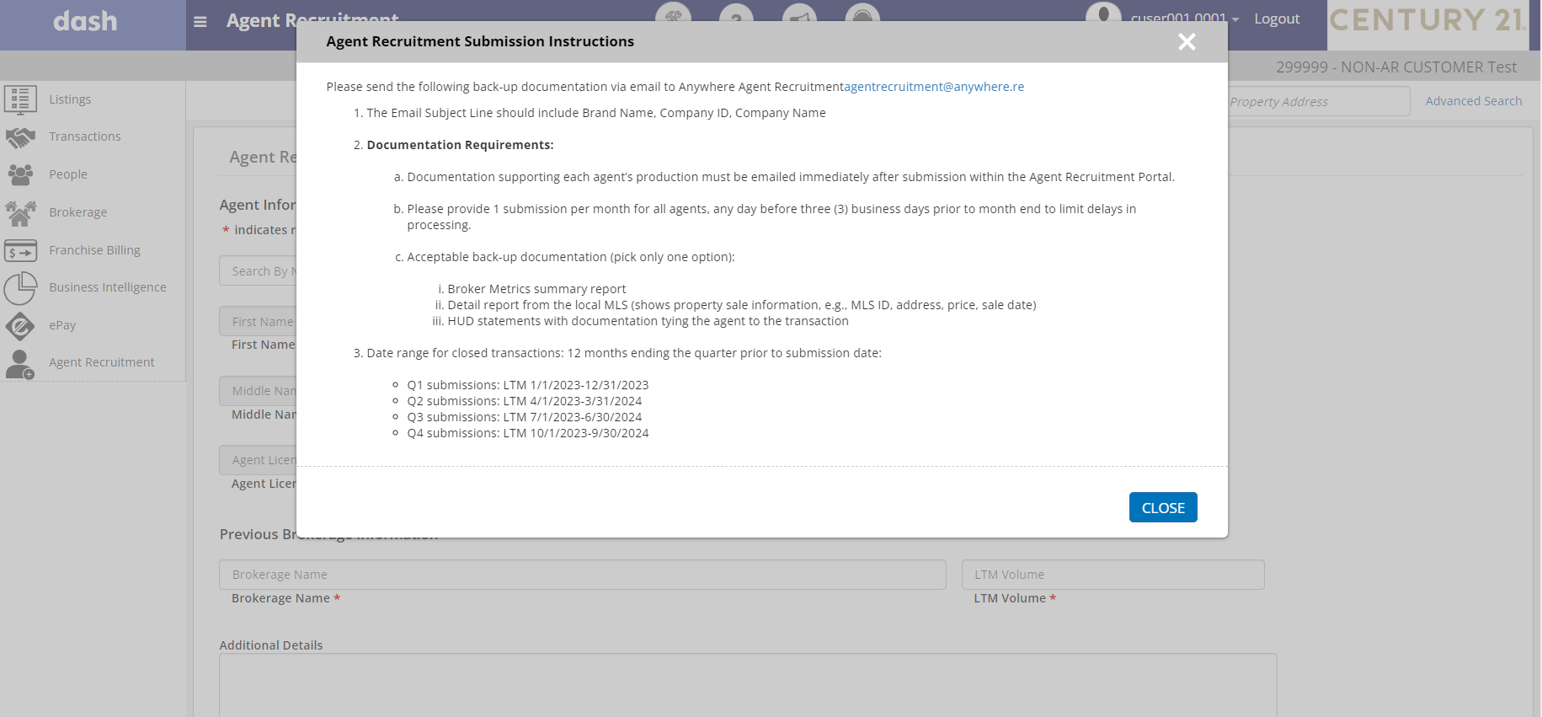
The AGENT RECRUITMENT SUBMISSION INSTRUCTIONS will display.
Please follow these instructions to complete the final step of submitting an agent. The agent detail documentation must be submitted via agentrecruitment@anywhere.re.

Slide 14
VIEWING THE POST AGENT SUBMISSION INSTRUCTIONS

Slide 15
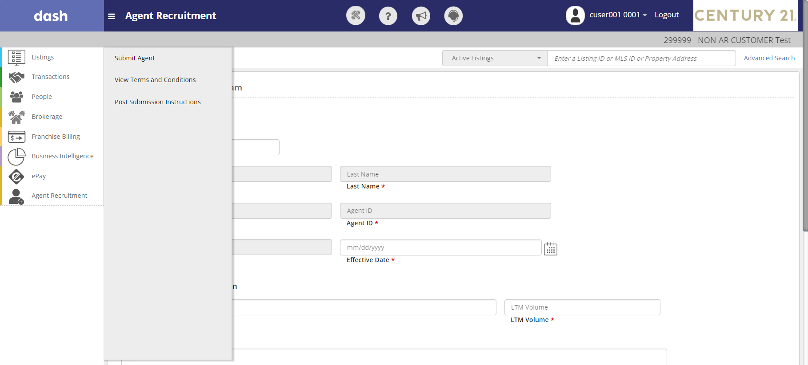
To view the POST SUBMISSION INSTRUCTIONS, Log into dash and select the AGENT RECRUITMENT tab. Click POST SUBMISSION INSTRUCTIONS.

Slide 16
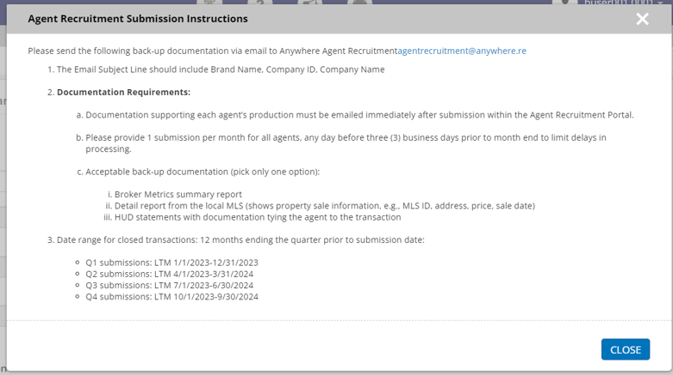
The POST SUBMISSION INSTRUCTIONS will display.

Slide 17
For additional information on the 2024 Agent Recruitment Program please refer to the 2024 FAQ located in the Help and How To Section within Dash

Slide 18
Thank You

